Slide 1
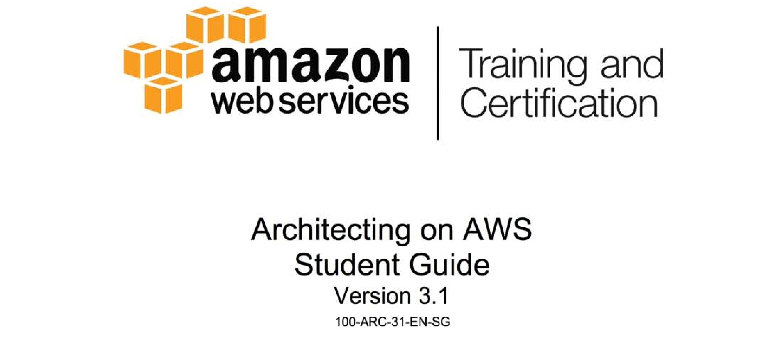
Notes:
1

Slide 2

Module 1: Knowledge Check
Notes:
2

Slide 3
Knowledge Check
What is the Cloud?
Notes:
3

Slide 4
Knowledge Check
How does AWS cloud computing differ from traditional IT infrastructure?
Notes:
4

Slide 5
Knowledge Check
There are 3 main methods of interacting with AWS. Can you list them? Which method is most commonly used by individuals new to AWS?
Notes:
5

Slide 6
Knowledge Check
What is an AWS Region?
Notes:
6

Slide 7
Knowledge Check
What are regions made of?
Notes:
7

Slide 8
Knowledge Check
Where can you get the latest information on the number of regions and Availability Zones within AWS?
Notes:
8

Slide 9
Knowledge Check
Where does AWS responsibility for security end and yours begin?
Notes:
9

Slide 10
Knowledge Check
Why would you use a security group? Can you give an example of how multiple security groups would work together?
Notes:
10

Slide 11
Knowledge Check
How do you extend your on-premise network into AWS?
Notes:
11

Slide 12
Knowledge Check
What type of storage system is S3?
Notes:
12

Slide 13
Knowledge Check
How do different EC2 instance types differ?
Notes:
13

Slide 14
Knowledge Check
There are three ways you can pay for EC2 instances. Can you name them?
Notes:
14

Slide 15
Knowledge Check
How many providers of Amazon Machine Image (AMIs) are there? Can you name them?
Notes:
15

Slide 16
Knowledge Check
Why would you choose EBS over instance storage?
Notes:
16

Slide 17
Knowledge Check
Why would you want to scale out your application, instead of scaling up?
Notes:
17

Slide 18
Knowledge Check
Why should you avoid using your AWS Master Account?
Notes:
18

Slide 19
Knowledge Check
What is the difference between a CloudFormation template and a CloudFormation stack?
Notes:
19

Slide 20
Knowledge Check
What advantages does a CloudFormation template have over a traditional network diagram?
Notes:
20

Slide 21
Knowledge Check
Where you can you go to find a variety of CloudFormation templates that you can try out?
Notes:
21

Slide 22
Knowledge Check
How can you keep track of your applications metrics in AWS? What types of metrics are available to you?
Notes:
22

